Slide 1
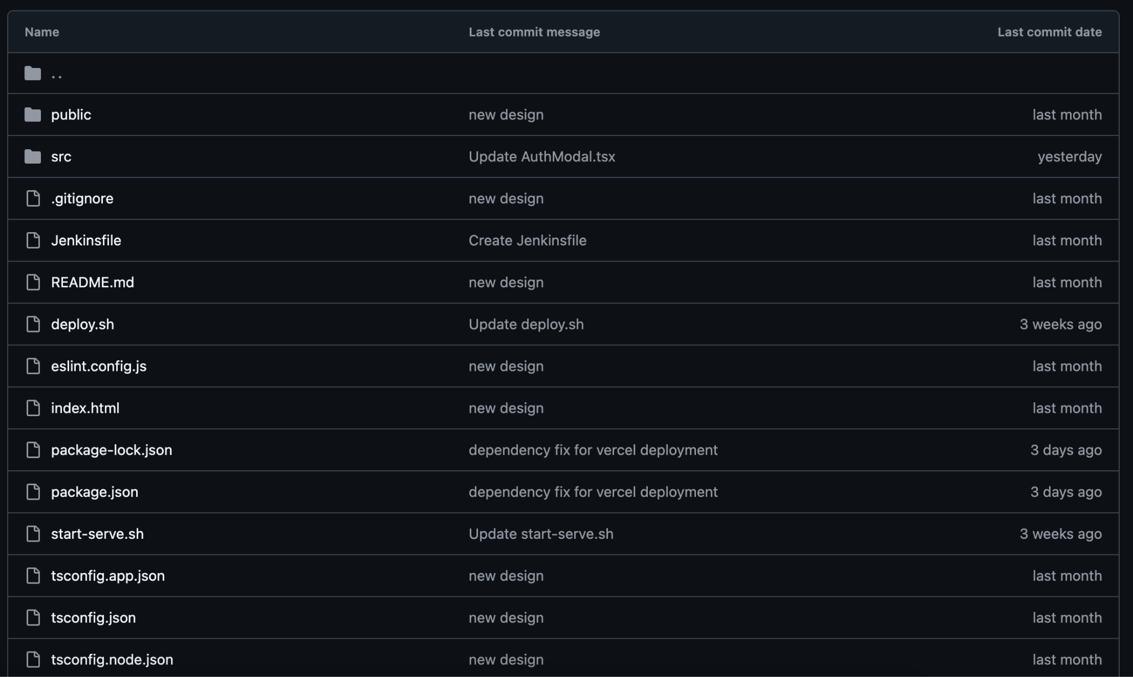
Github Repo Client Side

Slide 2
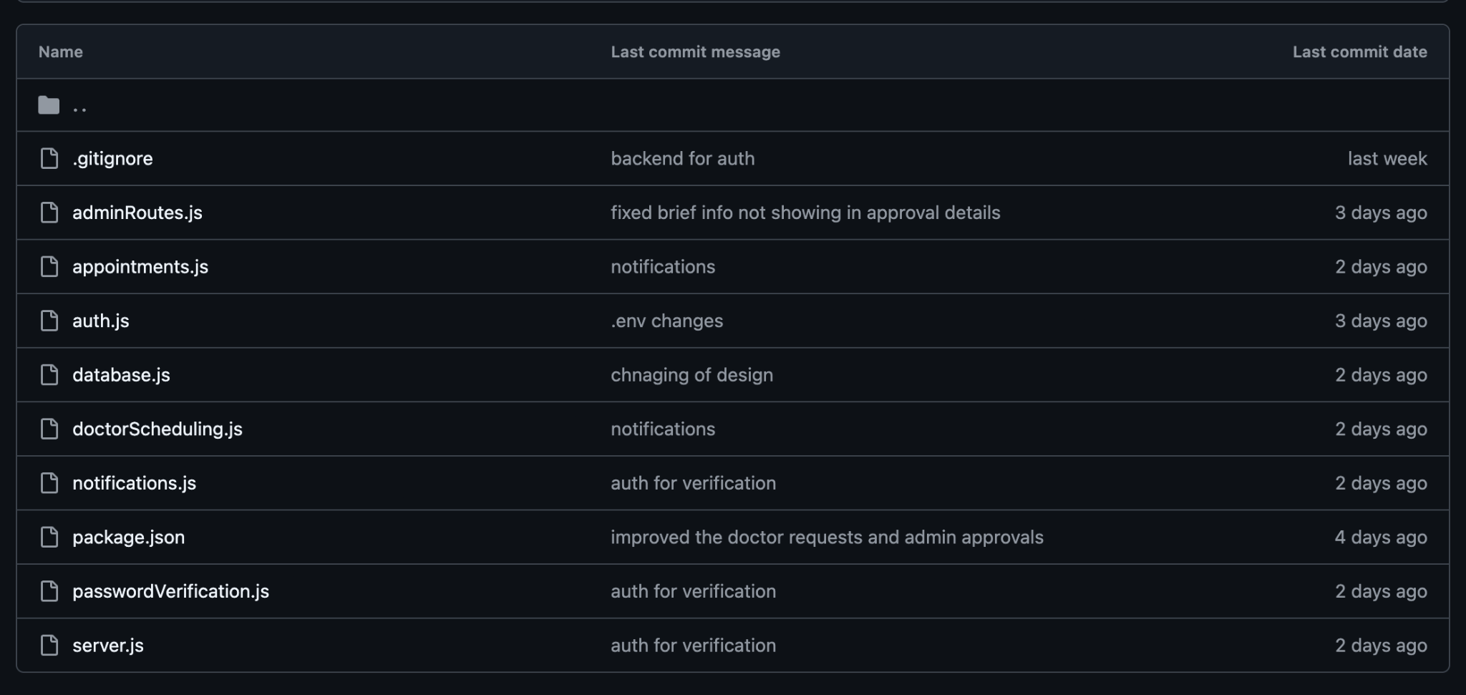
Github Repo Server Side

